Slide 1

Saying by your graph
奶茶
Xiao MAT
Simplifying your presentation

Slide 2

Content
R-WORKSHOP: VISUALIZATION
SEPTEMBER 2021

Slide 3

Human sees and understands the figure faster than wording
60,000 TIMES!
R-WORKSHOP: VISUALIZATION
SEPTEMBER 2021

Slide 4

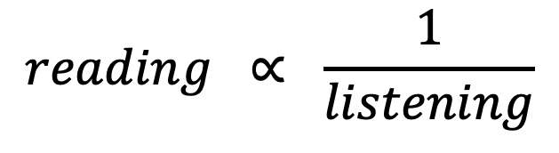
THE 3s LAW
$$reading ∝ \frac{1}{listening}$$
NANCY DUARTE
R-WORKSHOP: VISUALIZATION
SEPTEMBER 2021

Slide 5



ATTRACTIVE
CREDIBLE
Distinction with
color, size, and taste
Using of
figure, graph, and repetition
BODY
SUPPLEMENTARY
R-WORKSHOP: VISUALIZATION
SEPTEMBER 2021

Slide 6


TIPS #1
Use color to mention key message
35%
R-WORKSHOP: VISUALIZATION
SEPTEMBER 2021

Slide 7
TIPS #1
Use color to mention key message
35%
R-WORKSHOP: VISUALIZATION
SEPTEMBER 2021

Slide 8

Background color
Main color
TIPS #2
70
25
5
Accent color
Balancing the colors
Water condition of XTBG plants
35%
R-WORKSHOP: VISUALIZATION
SEPTEMBER 2021

Slide 9

Background color
Main color
TIPS #2
70
25
5
Accent color
Balancing the colors
Accent colors
R-WORKSHOP: VISUALIZATION
SEPTEMBER 2021

Slide 10
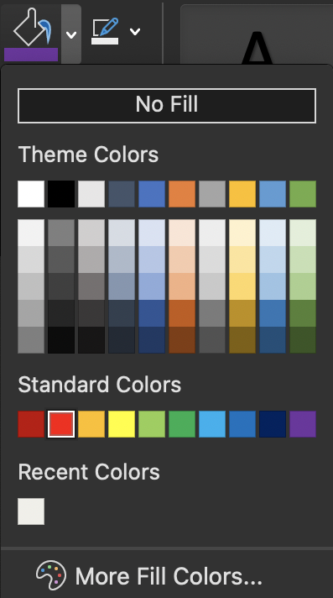
TIPS #2
Balancing the colors
Accent colors
R-WORKSHOP: VISUALIZATION
SEPTEMBER 2021

Slide 11
TIPS #2
Balancing the colors
saturation
Accent colors
brightness
R-WORKSHOP: VISUALIZATION
SEPTEMBER 2021

Slide 12
TIPS #2
Balancing the colors
35%
35%
R-WORKSHOP: VISUALIZATION
SEPTEMBER 2021

Slide 13

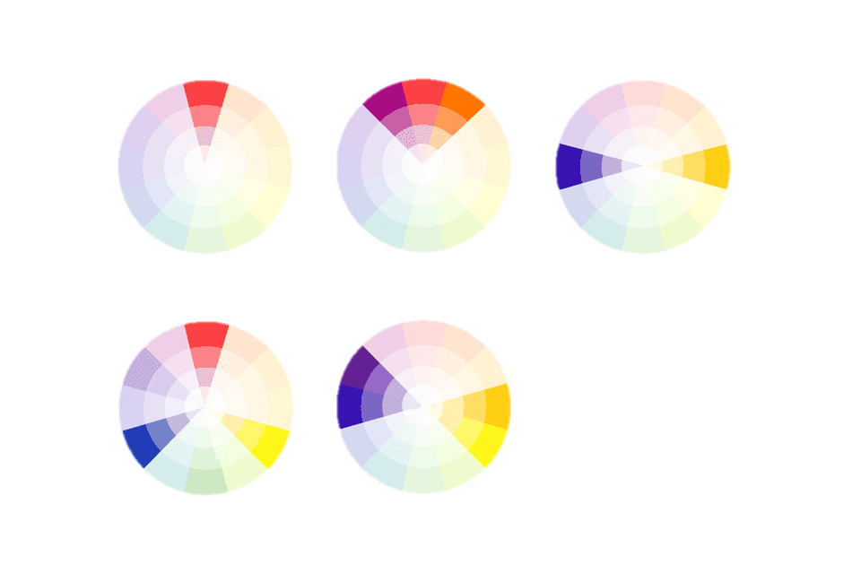
TIPS #3
Select the right color scheme
Monochrome
Analogous
Complimentary
Triad
R-WORKSHOP: VISUALIZATION
SEPTEMBER 2021

Slide 14
TIPS #3
>3 groups is not suggested
Select the right color scheme
Monochrome
Analogous
Complimentary
Triad
Universally used
Distinguished
Treated 3 groups equally
R-WORKSHOP: VISUALIZATION
SEPTEMBER 2021

Slide 18



Mean annual
precipitation
STF
TRF
TEF
SAV
1,728 mm
TIPS #2
1,415 mm
1,095 mm
Balancing the colors
734 mm
Mean annual temperature
Background color
7.9ºC
11.7ºC
21.4ºC
24.3ºC
70
Main color
25
Accent color
TEF
STF
TRF
SAV
5

